Slide 1





BRITISH AIRWAYS CUSTOMER REVIEW ANALYSIS
customer reviews scraped from British Airways!

Slide 2

INTRODUCTION
We scraped and analyzed 1,000 verified British Airways customer reviews using Python and BeautifulSoup. This analysis identifies key customer sentiment trends and highlights areas of strength and improvement based on real passenger feedback..

Slide 3


Tools Used
Python
Pandas
BeautifulSoup
Seaborn
matplotlib
WordCloud

Slide 4


Goal
Extract data-driven insights to enhance customer experience and operational excellence

Slide 5

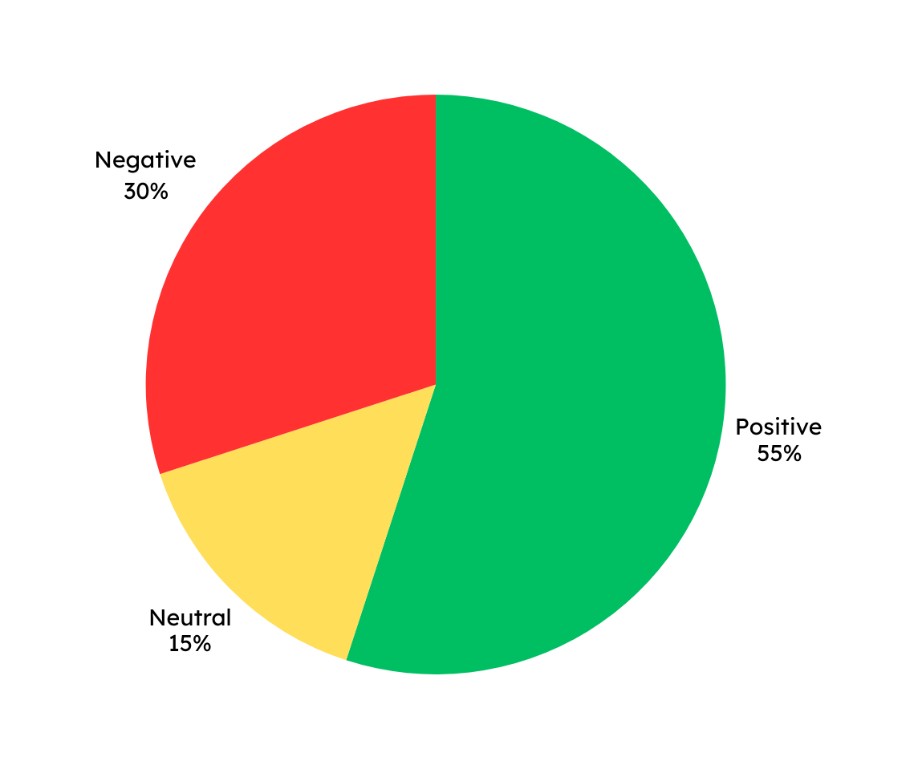
Sentiment Breakdown
The sentiment analysis revealed that a majority of customers had a positive experience. However, nearly 1 in 3 reviews reflected dissatisfaction, highlighting recurring service challenges. Neutral sentiments suggest potential for converting undecided customers through targeted improvements.

Slide 6
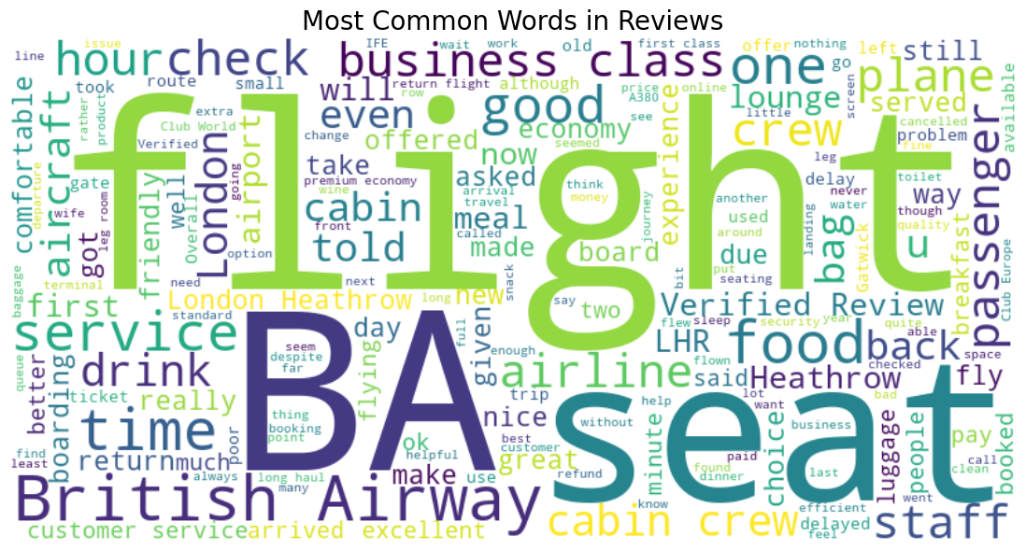
Word Cloud
By visualizing word frequency, we identified recurring topics that matter most to travelers. Positive mentions revolve around staff and onboard comfort, whereas complaints often highlight flight delays, baggage handling, and check-in inefficiencies..

Slide 7

Key Metrics Table
These metrics offer a quick glance at performance areas. While frontline staff consistently earn praise, operational shortcomings such as delays and baggage mishandling continue to impact customer satisfaction.
Metric | Value
Total Reviews Analyzed | 1000
Top Praise | Friendly crew, in-flight service
Top Complaints | Flight delays, baggage handling

Slide 8
Actionable Insights & Strategic Takeaways
To drive a better Net Promoter Score (NPS) and elevate brand perception, we recommend investing in core pain points while leveraging existing service excellence.
Prioritize flight punctuality and baggage handling improvements
Recognize and retain high-performing crew members
Implement real-time customer feedback loops
Address neutral reviews through personalized follow-up strategies

Slide 9

Thank You
Towards Smarter Decisions.
Towards Better Experiences.
Together.

